Slide 1
Introduction Spring Security
Cornelis de Mooij

Slide 2
Planning
Theory:
Hashing
Hashing & salting
Authentication & Authorization
Asymmetric cryptography
Public Key Encryption
Digital Signatures
Practice:
Spring application with username & password
Spring application with authorization-token (JWT)
Spring application with service-service authorization with OAuth

Slide 3
Hashing
What is hashing?
How does hashing work?
Applications of hashing

Slide 4
What is hashing?
A way to turn data of any size into something with a fixed size
For security, that’s not enough. Should also be hard to:
Find input for a specific output
Find different input that produces the same output
Find two different inputs that produce the same output
Then, it’s “Cryptographic Hashing”

Slide 5
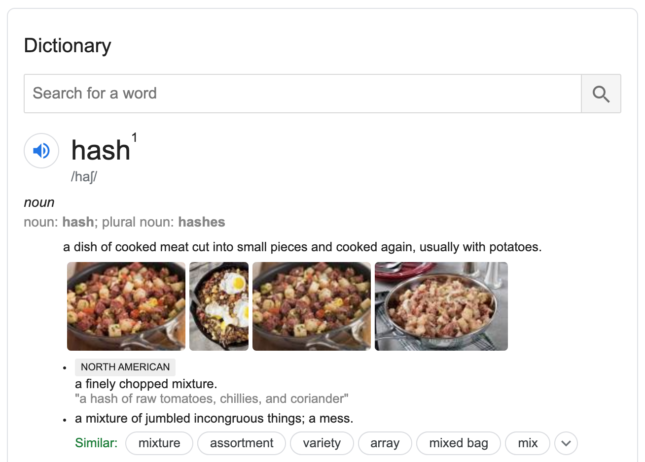
What is hashing?

Slide 6
How does hashing work?
Many methods
Focus on one modern cryptographic hash: SHA-512
Complicated, don’t worry about implementing it, we won’t.

Slide 7
Hashing with SHA-512
Pad message with (100…000) and message length
Cut padded message into 1024-bit blocks
Set previous hash to 512-bit initial vector (IV, SHA-512 constant)
Loop over blocks:
Combine previous hash and block with “Rounds and Addition”
Store resulting hash as previous hash and repeat
Return resulting hash from last block

Slide 8
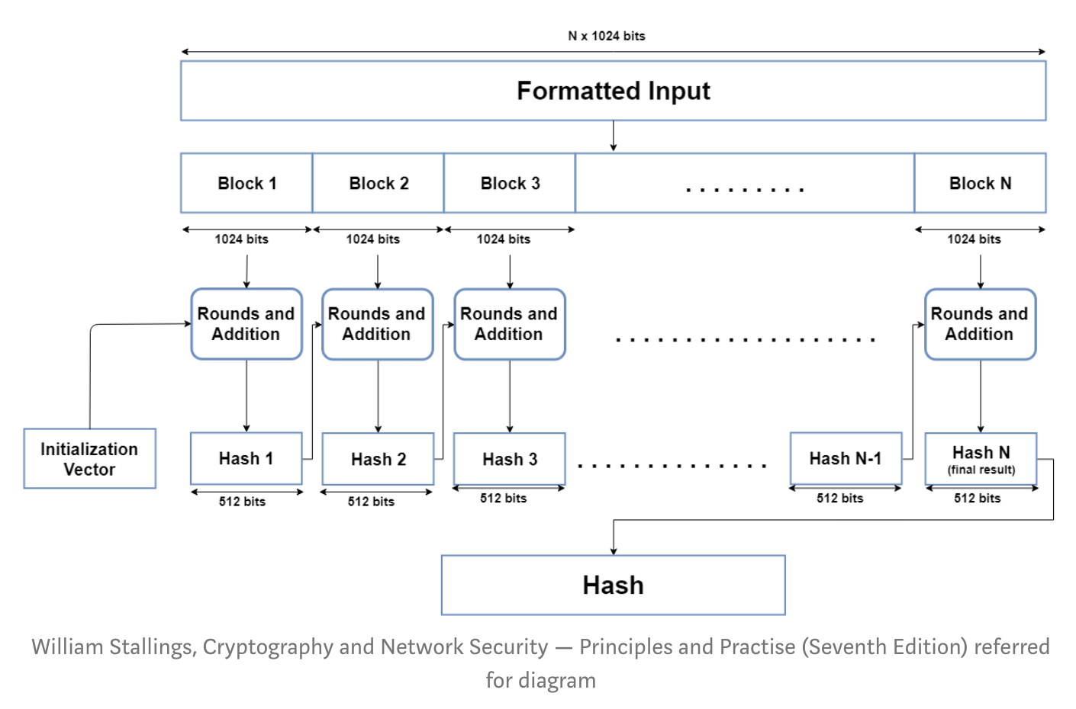
Hashing with SHA-512

Slide 9
Hashing with SHA-512 Rounds & Addition
“Sequence” a 1024-bit block into 80 64-bit “words”
Loop over the words:
Combine word i with result from previous word and SHA-512 constant i
Save result for use in next Round
Take result from last Round and perform Addition with result hash from previous block, to find result hash for this block

Slide 10
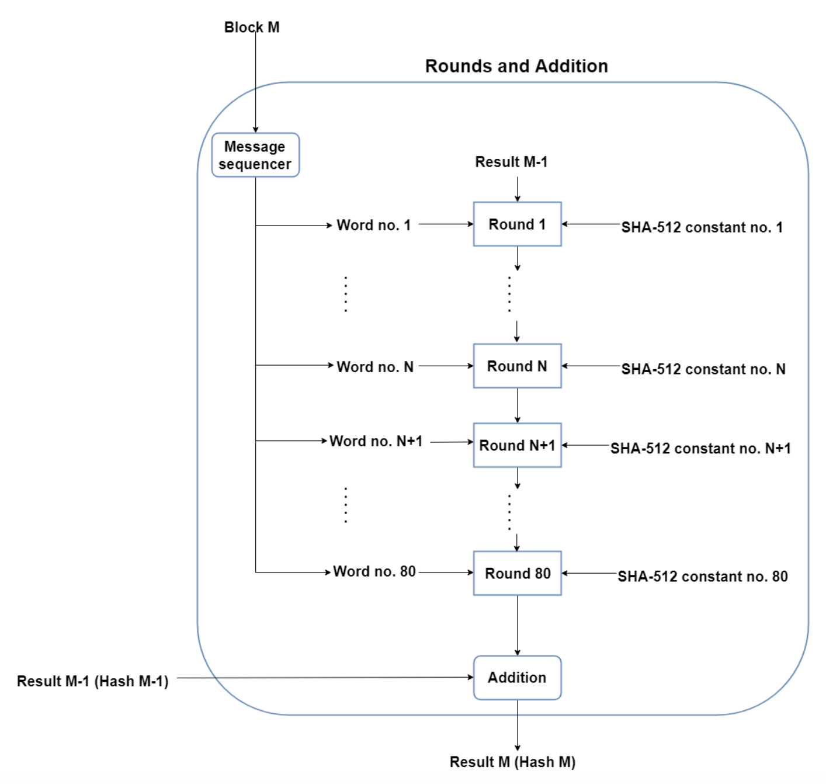
Hashing with SHA-512 Rounds & Addition

Slide 11
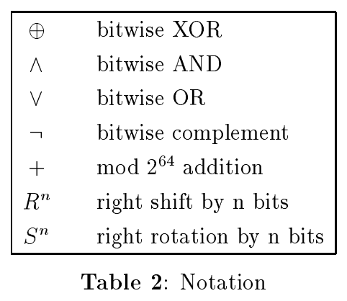
Hashing with SHA-512 – Rounds
Rounds are complicated, not covered here
Use these hard-to-invert operations:
For full spec, check http://www.iwar.org.uk/comsec/resources/cipher/sha256-384-512.pdf

Slide 12
Applications of hashing
Integrity verification: small errors (or malicious changes) will change the hash. Faster to compare just the hash.
Digital signatures: will explain how this works later, but without hashing the signature would be the size of the thing being signed. With hashing, the signature is the size of the hash.
Password storage: storing passwords in plaintext is a security risk. Instead, store the hash. When a password needs to be verified, compute the hash, compare, then throw away the password.
Proof-of-work: DDoS, Cryptocurrency
Identifiers: Git, torrents, hash tables, bloom filters
Notes:
Ask the group first.

Slide 13
Hashing & Salting
Short passwords vulnerable to bruteforce attacks
Rainbow tables
Solution (partial, not perfect): salting
Append random string (the salt) to password before hashing
Store salt with hash
Bruteforce still possible but much more effort
Can’t help you if you pick one of these:
wikipedia.org/wiki/List_of_the_most_common_passwords
Notes:
sudo cat /etc/shadow
openssl passwd -6 -salt <salt> <password>

Slide 14
Rainbow Tables

Slide 15
Authentication & Authorization
Authentication: Proving who you are.
Authorization: Proving what you are allowed to do.
Authorization can be handled implicitly, by attaching what you can do directly to who you are.
Authorization can also be handled explicitly, separating what you can do from who you are.
Vague? Let’s implement both.

Slide 16
Spring web app without security:
App
Servlet
Servlet
Servlet
Servlet
Notes:
Servlets bedienen specifieke endpoints

Slide 17
Spring web app with security:
App
Filter
Servlet
Servlet
Servlet
Servlet
Notes:
Filters bedienen (met default instellingen) alle endpoints

Slide 18
Spring web app with security:
App
Filter
Filter
Filter
Filter
Servlet
Servlet
Servlet
Servlet
Notes:
Filters bedienen (met default instellingen) alle endpoints

Slide 19
Spring Security default settings
Required authentication for all endpoints
Login screen
Handler for login errors
Makes user and generates password
Notes:
Gebruikersnaam is “user”, wachtwoord verschijnt in de terminal waar de app draait

Slide 20
Practice: Spring application with username & password
Notes:
https://docs.spring.io/spring-security/site/docs/current/reference/html5/#user-schema

Slide 21
Spring web app with security:
Filter
Authentication
AuthenticationProvider
authenticate()
supports()
Credentials
AuthenticationManager
authenticate()
Input
AuthenticationProvider
authenticate()
supports()
UserDetailsService
loadUserByUserName()
Output
Authentication
AuthenticationProvider
authenticate()
supports()
Credentials
Notes:
Filters bedienen (met default instellingen) alle endpoints

Slide 22
Practice: Spring application with authorization token (JWT)

Slide 23
Asymmetric cryptography

Slide 24
Public Key Encryption

Slide 25
Digital Signatures

Slide 26
Spring application with service-service authorization with OAuth

